Slide 1



Appointment Scheduling for Sample Collection

Slide 2



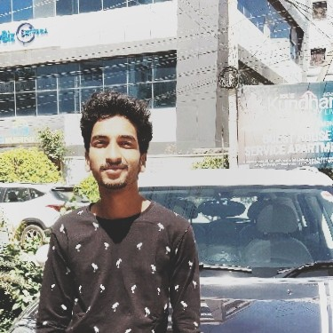
TEAM MENTORS
Mr. Bharani Kumar Depuru
Director: 360digiTMG
https://www.linkedin.com/in/bharanikumardepuru/
Mr. Sharath Manikonda
Director : Innodatatics
https://www.linkedin.com/in/sharat-chandra
Ms. DivyaJanani S
Project Mentor
https://www.linkedin.com/in/divyajanani-s-256981211
Mekala Madhan Kumar
Project Mentor
https://www.linkedin.com/in/mekala-madhan-kumar-348014194/

Slide 3






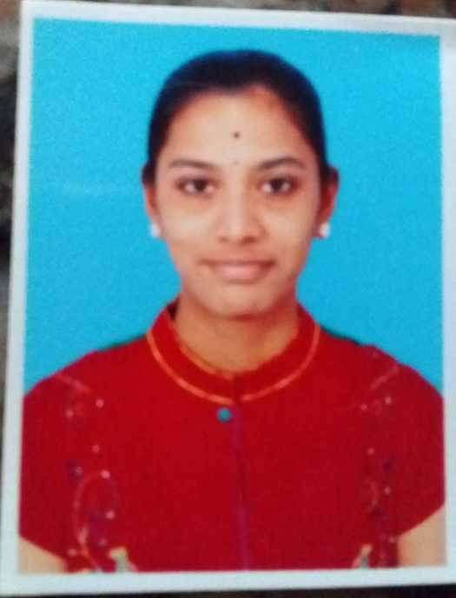
TEAM MEMBERS
AVASARALA SAI KIRAN
https://www.linkedin.com/in/sai-kiran-avasarala-798b93175/
ARIKA N.
https://www.linkedin.com/in/naikoti-arika-9110b322b/
ADITI NATH
https://www.linkedin.com/in/aditi-nath-81a60b226
BHAVESH PANSE
https://www.linkedin.com/in/bhavesh-panse/
BINDUSHREE S.
https://www.linkedin.com/in/bindushree-s-b32410172
NISHA ARUNKUMAR
https://www.linkedin.com/in/nisha-arunkumar-b3b494215/
VINODHINI S.
https://www.linkedin.com/in/vinodhini-s-367174191

Slide 4

CONTENTS
Introduction
Project Overview
Project Goals
Business Pipeline
Technical Stacks
Project Architecture
Data Collection
Data Preprocessing
Exploratory Data Analysis
Data Visualization
Model Deployment
Working of deployed model
Output
Future scope
Conclusion

Slide 5
INTRODUCTION
The project aims to streamline and give a proper schedule for sample collection.
Plans schedules, assign tasks to specific field Agents based on number of parameters configured through Pathology Lab business rules.
Route optimization helps Agent to find the best way to get from source to destination under unforeseen conditions and real-time traffic.
A summary of the timing of all sample collections is provided in Table to Sample Collection Agent.
Provides route optimization to Agents.
Diagnostics at Doorstep with hospital-standard reporting, expert technicians & high-precision equipment.
Dependable and convenient service, rest assured with all the required tools to do the needful.
Clustering helps to group a set of locations of patients based on various parameters such as distance, availability, orders, etc

Slide 6

PROJECT OVERVIEW
How to overcome wastage of medical sample?:-
How can our model help this?
Fundamental idea is to identify the formation of clusters(groups) for given medical sample collection data of particular date.
Machine learning can be used to know the patterns in given data and cluster them accordingly.
The complete project comes up with the idea to help diagnostic center to Sample Collection Schedule of patients generating clusters by Agent ID and assigning to an Agent for at-home sample collection for a given date.
Dynamic and automated scheduling facilitates intelligent scheduling, work order allocation, and planning to reduce agent downtime and costs significantly. It also allows a combination of batch and real-time scheduling.

Slide 7

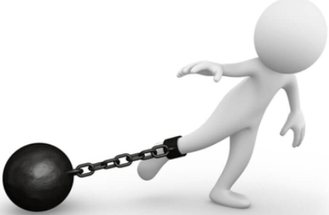
PROJECT GOALS
Objectives
Constraints
To build a web app for predicting the schedule of a particular agent on a given date.
Make sure to use terms like Minimize and To increase the overall growth of diagnostic center.
The model may get impacted by unforeseen conditions like weather conditions and customers absence.
Agents Unavailability.

Slide 8
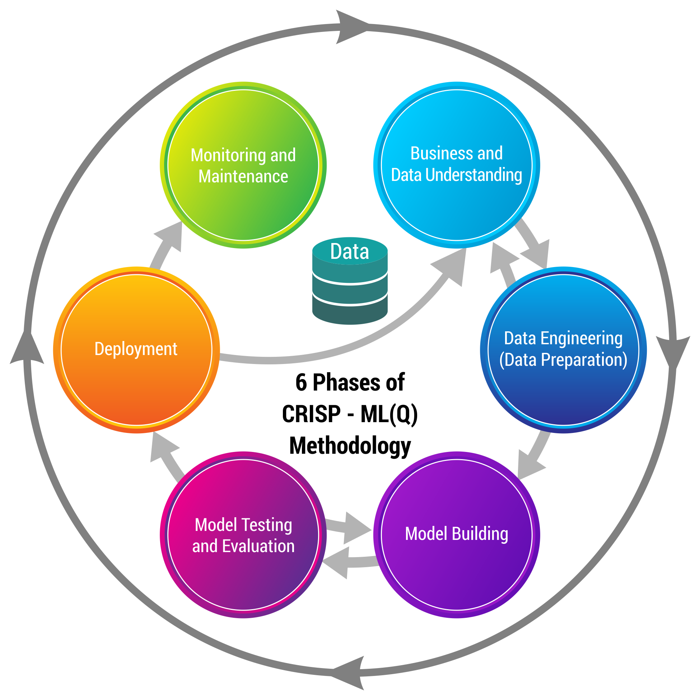
BUSINESS PIPELINE
CRISP-ML(Q) Methodology

Slide 9




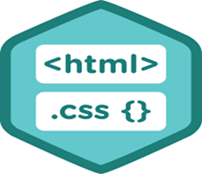




TECHNICAL STACKS
MySQL is used to import and export SQL files into database.
Tableau – is used for data visualization
Python - Used for Data Collection, Data pre processing
and Model Building
Flask, HTML and CSS – used for Web Framework.
The IDEs essential building blocks, include advanced editing, code analytical tools, IPython Console, variable explorer, plots, debugger and the help
Heroku and GitHub: is used for web application deployment.

Slide 10
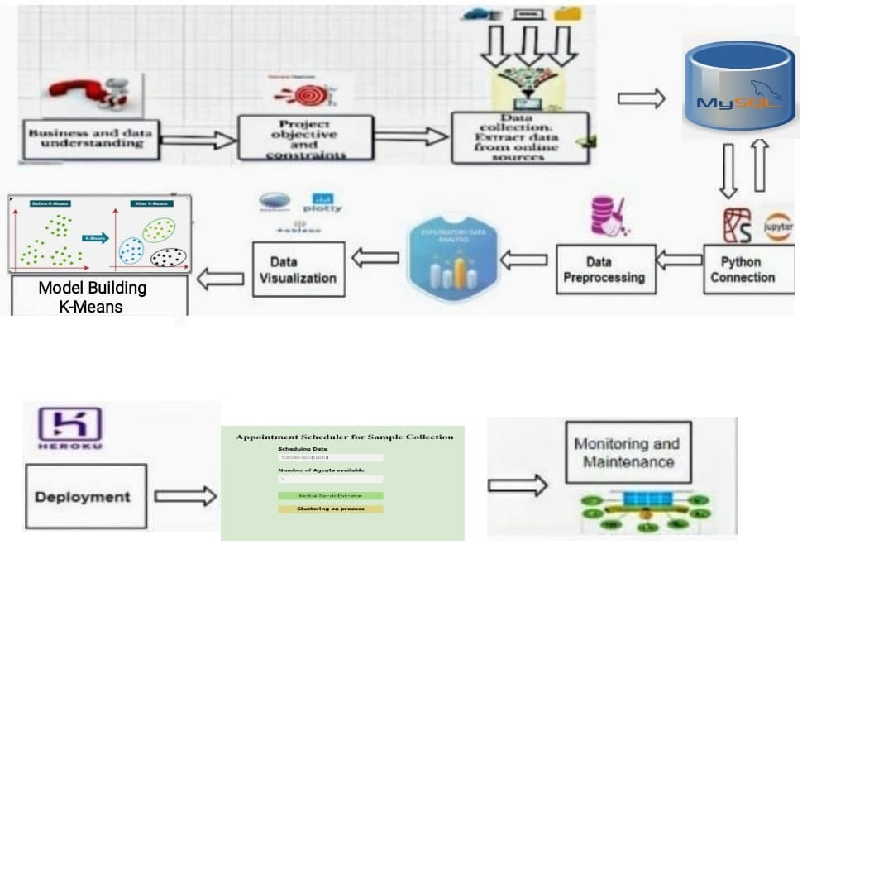
PROJECT ARCHITECTURE

Slide 11

PROJECT ARCHITECTURE
Dropping unwanted data columns.
Filtering data according to given date.
Taking the availability of agents.
Clustering according to agents availability.
Taking the agent's ID.
Filtering the data according to given agent's ID.
Sorting the data according to availability time of patients.
Showcasing required columns for agent.

Slide 12

DATA COLLECTION

Slide 13

DATA COLLECTION
Data was simulated one. Certain inputs were randomly generated using codes. Finally, the data was combined and converted to excel. Dataset has 1336 rows and 26 columns.
Dataset has following useful features:-
1. Patient ID: ID Given to the patient on booking the test
2. Agent ID: ID of the agent assigned to pick the sample
3. Pincode: Patient area Pincode, where the sample must be collected
4. Patient’s Location: Area of the patient. 5. Diagnostic Centers: Name of the diagnostic center where the sample must be delivered.
6. Availability Time (Patient): Patient availability for sample collection.
7. Shortest distance Patient-Pathlab: The shortest distance between patient and pathology lab
8. Test name: Name of the test booked
9. Sample: The kind of sample to be collected for that particular test booked
10. Way Of Storage Of Sample: How the sample is stored
11. Sample Collection Date: The date on which the patient asked the sample to be collected.

Slide 14
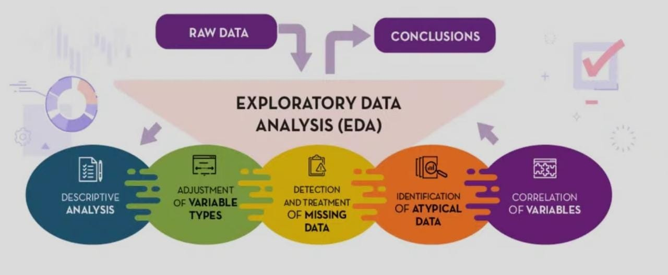
EXPLORATORY DATA ANALYSIS(EDA)

Slide 15
EXPLORATORY DATA ANALYSIS (EDA)
Dataset Statistics:
Number of variables : 26
Number of observations : 1336
Missing values found : 0
Duplicate rows found : 0
Total size in memory : 115 KB
VARIABLE TYPES:
Categorical : 17
Numerical : 8
Date Type : 1

Slide 16
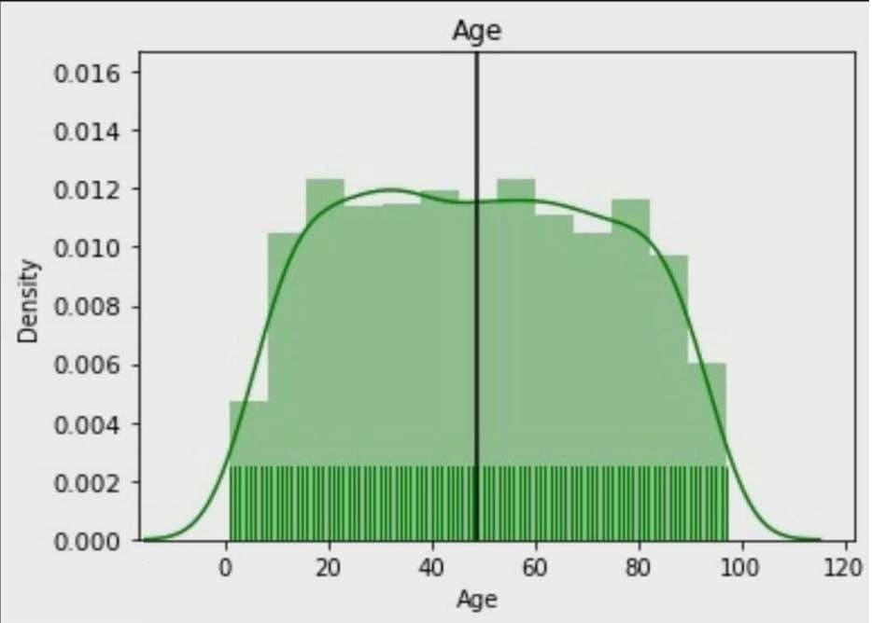
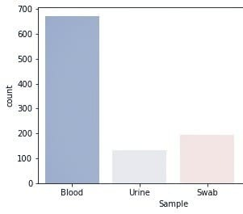
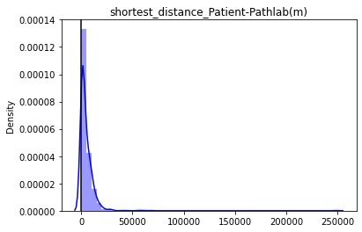
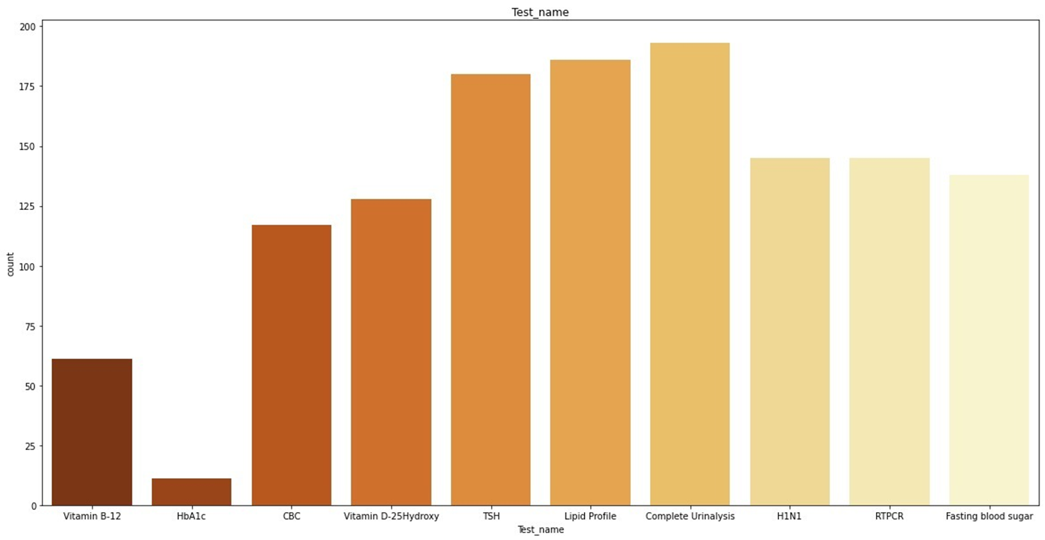
EXPLORATORY DATA ANALYSIS (EDA)
INFERENCE: Maximum No. of patients are in age group 20-80
INFERENCE: Blood is the highest collected sample for tests.
INFERENCE: Complete Urinalysis has the highest rank in all the performed.
INFERENCE: 98% of the people are under 25 KM distance.

Slide 17
DATA PRE-PROCESSING
Data Preprocessing Techniques Applied:
Missing data handling: No missing values found
Duplicate data: No duplicate data observed.
Relevant data: Only relevant variables are considered for model building.
Label encoding: Categorical encoding in which categorical values are replace with numerical values between (0) and (no. of classes -1).
Standardization: Standardize the data to have a mean of 0 and standard deviation of 1,
since the feature in dataset have different units of measurement.
Note: No outliers treatment was performed since every data is unique, same data was retained.

Slide 18
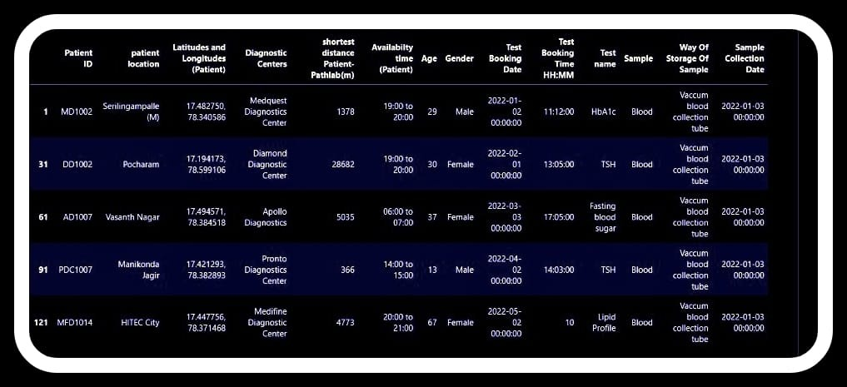
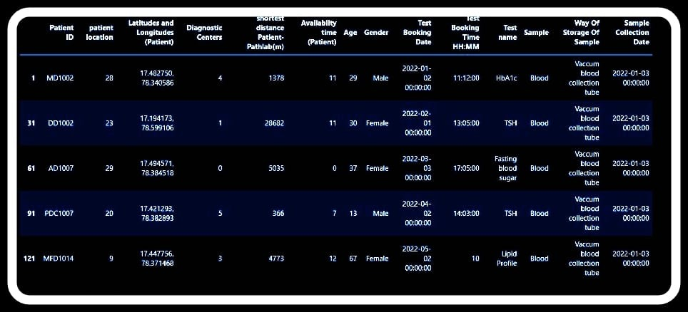
DATA PRE-PROCESSING
Before Applying Label Encoding
After Applying Label Encoding

Slide 19
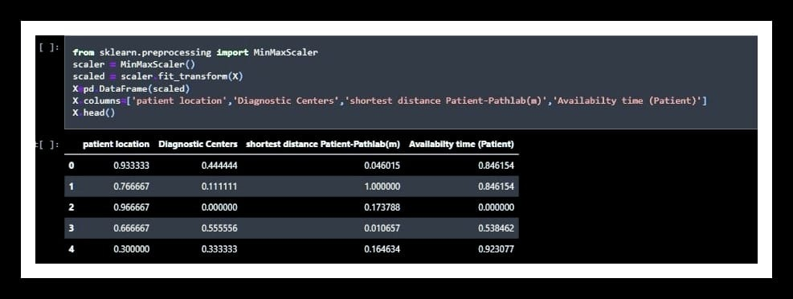
STANDARDIZED DATA
K-Means algorithm does not work with categorical data, so we normalized the data within the range of 0 to 1 to fetch clusters.

Slide 20
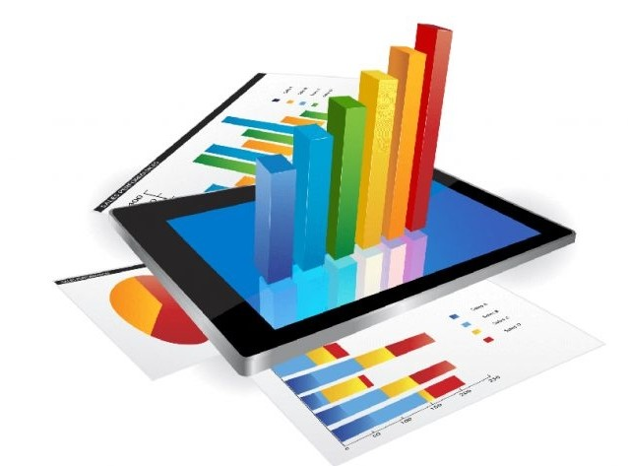
DATA VISUALIZATION

Slide 21
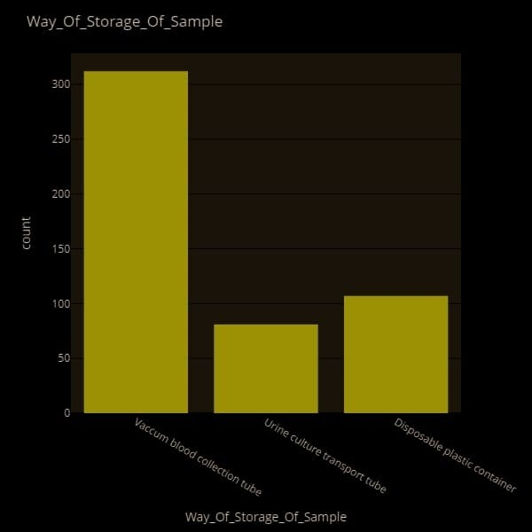
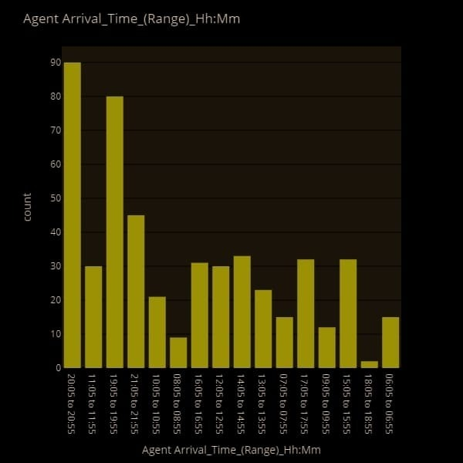
LOCATION/TIME VISUALISATION
INFERENCE:
INFERENCE: Maximum specimens collected by agent in b/w 19:00 to 21:00 hours

Slide 22
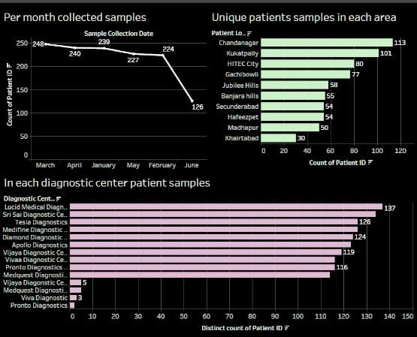
DATA VISUALIZATION

Slide 23
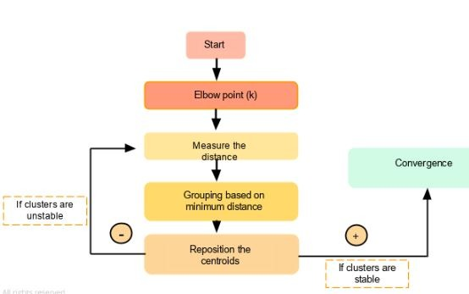
http://ba-finance-2013.blogspot.com/2012/09/k-means-clustering.html
MODEL BUILDING

Slide 24
MODEL BUILDING
Clustering algorithm works by iteratively connecting closest data points to form clusters. Initially, all data points are disconnected from each other; each data point is treated as its own cluster. Then, the closest data points are connected, forming a cluster.
Packages used:
Pandas is a package used for data manipulation and analysis.
NumPy is a package used to perform a wide variety of mathematical operations on arrays.
Matplotlib is a popular Python package used for data visualization.
Mysql.connector is used to connect MySQL to python.
sklearn.preprocessing import LabelEncoder is a function used to transform non-numerical data to numerical data.
sklearn.preprocessing import MinMaxScaler is used to perform standardization on different units of Dataset.
sklearn.cluster import Kmeans is used to perform Kmeans clustering on dataset to create no. of clusters.

Slide 25
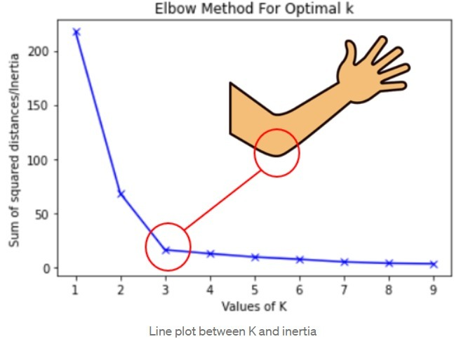
K-MEANS CLUSTERING
K-means clustering: is a method of vector quantization, originally from signal processing, that aims
to partition n observations into k clusters in which each observation belongs to the cluster with the nearest mean (cluster centers or cluster centroid), serving as a prototype of the cluster.
Elbow Curve Method: Elbow curve is used to select optimal number of clusters to perform K-Means clustering Elbow Method is more of a decision rule.
Silhouette Analysis: The silhouette coefficient (score) is a measure of how similar a data point is within-cluster (cohesion) compared to other clusters (Separation).
Silhouette is a metric used for validation while clustering.

Slide 26
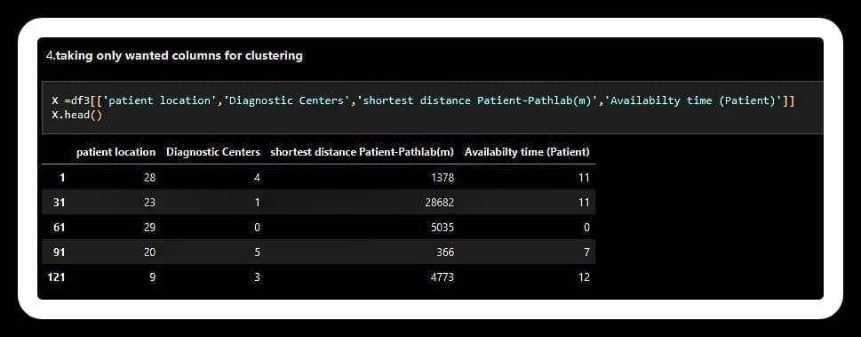
MODEL EXPLANATION
Columns used for clustering:
Shortest distance Pathlab-Patient : After specimen collection of patient it helps agent to deliver specimen back to diagnostic center.
Availability Time: It is main component which says about availability time of patient.
Patient location: We considered patient location in clustering, which is necessary to target clustering based on similar locations.
Diagnostic center location: We considered diagnostic center location as it would be easy while clustering similar points with respect to same diagnostic centers.

Slide 27
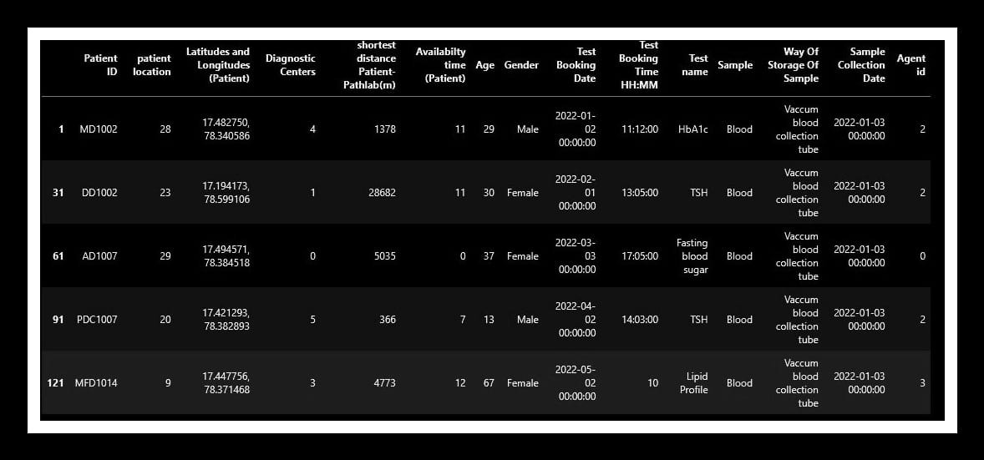
MODEL EXPLANATION
Technique:
Irrelevant columns were dropped which are not useful for our objective.
Label encoded the categorical columns to convert the into a numeric form so as to convert them into the machine-readable form.
Standardization is done using Min-Max scaler to obtain scaled data points of four dimensions (x1,x2,x3,x4) where x1,x2,x3,x4 represent respective particular column values as mentioned before.
The random points are selected based on agents availability and shortest distance is calculated and after each iteration we get clusters, process continues until proper clusters were formed.
Once proper clusters are formed, it stops the process and generates labels to each data point for a particular selected date.

Slide 28
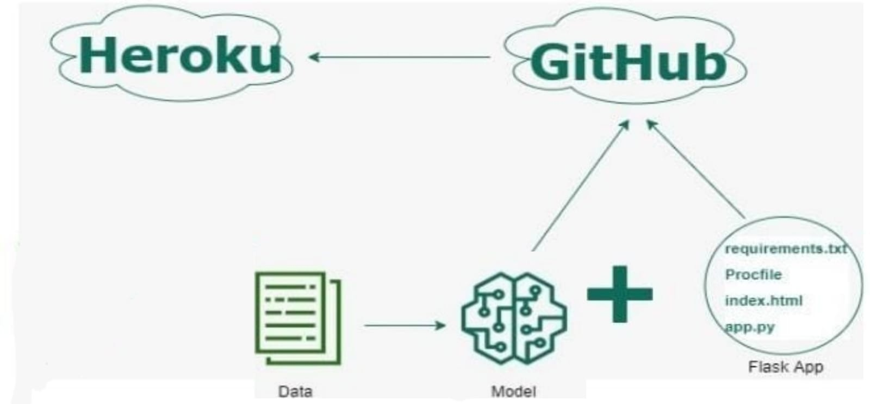
MODEL DEPLOYMENT
WEB BASED
DE

Slide 29
MODEL DEPLOYMENT
Steps for deployment on Heroku using Flask
Create Flask files for UI and python main file (app.py) that can deploy the machine learning model from step 1 for prediction.
Create requirements.txt with all python dependencies.
Create Procfile to run Flask app.
Commit files from Step 1, 2. 3 & 4 in the GitHub repo.
Create account/Login on Heroku, create an app, connect with GitHub repo, and select branch.
Select manual deploy on Heroku.
DEPLOYMENT LINK FOR Appointment Scheduling for Sample Collection
APP
Network URL: https://appointmentschedulermed.herokuapp.com/

Slide 30
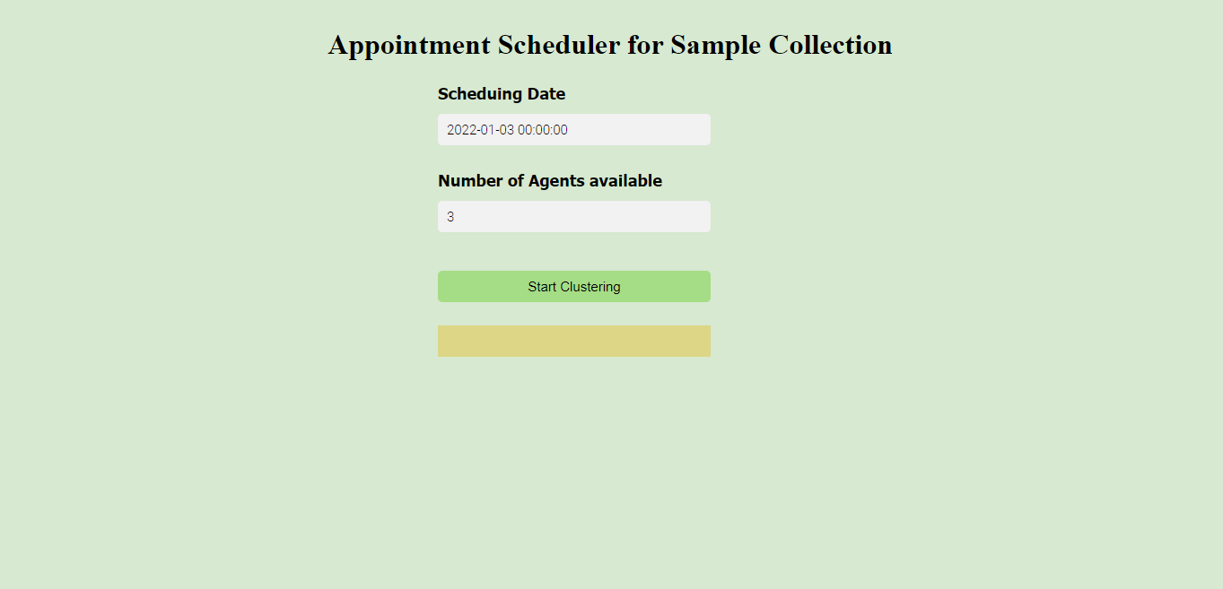
OUTPUTS OF THE DEPLOYED MODEL
Outputs of
Universal Sentence Encoder:

Slide 31
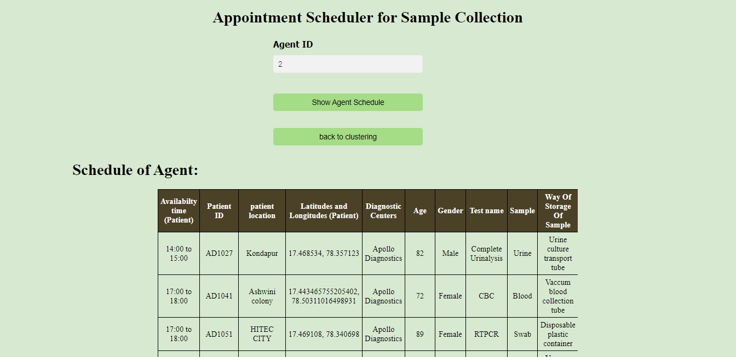
OUTPUTS OF THE DEPLOYED MODEL
Outputs of
Universal Sentence Encoder:

Slide 32
FUTURE SCOPE
Intelligent capacity management of Sample Collection Agents with auto calculation based on primary zone, jobs, availability, location, proximity, leaves, and more.
Ensures the lesser number of visits with preferred time slot selection, document checklists.
Avoid Long wait times and queue at diagnostic labs.
Provides optimal route suggestions via the patient location coordinates to reduce travel time and distance
Non-linear communication due to multi-party touch-points.
Avoids incorrect sampling and patient records.
Helps conduct medical tests at home if the patient cannot go to the Diagnostic Centre.

Slide 33
CONCLUSION
Machine learning can be used to know the features and characteristics of timings of sample collection , transport ,sample type , other constraints and to suggest the safety of the medical sample.
The complete project comes up with the idea to help diagnostic centers to automate Sample Collection.
Schedule of patients generating clusters by Agent ID and assigning to an Agent for at-home sample collection for a given date.
From this we can conclude that this model is one of the best model which is useful in present world which will be much more beneficial for Diagnostic centers.
Easy-to-use, intuitive user experience with multi-device compatibility designed for the quick onboarding.
Intelligent capacity management of field agents with auto calculation based on primary zone, jobs, availability, location, proximity, leaves, and more.

Slide 34


